Slide 1
Dr. Garry Prentice
garry.prentice@dbs.ie

Slide 2
“Applicants must obtain a minimum of four GCSE passes at grade C to include Maths and English plus two A-level passes at grade C or higher”
— Dublin Business School Website (www.dbs.ie/entry-requirements)

Slide 3
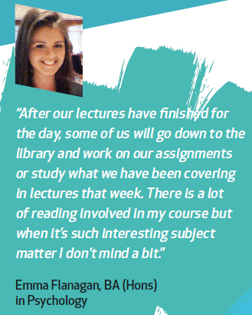
INTRODUCTION
Accreditation
Psychology degree coverage
Assessment
Academic calendar
Timetable
Student services
Library
Student academic support
Early alert (student retention)
Additional information

Slide 4
Aligned to BPS

Slide 5
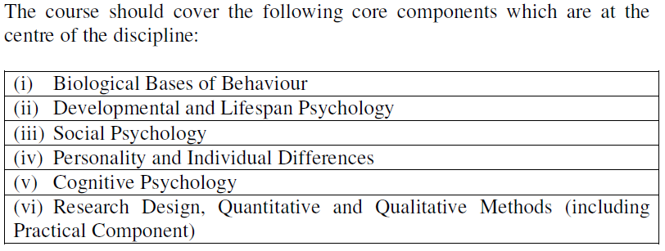
Accreditation:
Core areas

Slide 6
Psychology Year 1
Semester 1
Psychological foundations (10)
Foundations in Social Psychology (5)
Foundations in Biopsychology (5)
Academic Skills Lab (5)
Research Technique & Analysis 1 (10)
Introduction to Psychoanalysis and the Unconscious (10)
Semester 2
Psychological foundations continued
Developmental Psychology (5)
Fundamentals of Cognitive Psychology (5)
Adult Skills, Social and Emotional Training (5)
Research Technique & Analysis 1 continued
Introduction to Psychoanalysis and the Unconscious continued

Slide 7
Psychology Year 2
Semester 1
Modelling Cognitive Systems (5)
Development across the lifespan: Adolescence and Adulthood (5)
Experimental Psychology (5)
Ethical Research Methods & Design (10)
Research Technique & Analysis 2 (10)
Personality and Psychoanalytic Subjectivity (10)
Semester 2
Fundamentals of Biopsychology (5)
Social Psychology (5)
Psychology in Action – Online (5)
Ethical Research Methods & Design continued
Research Technique & Analysis 2 continued
Personality and Psychoanalytic Subjectivity continued

Slide 8
Psychology Year 3
Semester 1
Internet Mediated Research – online (M) (5)
Behaviour Science (M) (10)
Organisational Psychology (E) (5)
Health Psychology (E) (5)
Hysteria (E) (5)
Sexuality 1 (E) (5)
Semester 2
Neuropsychopharmacology (M) (5)
Behaviour Science continued
Human Performance (E) (5)
Mental Health and Distress (E) (5)
Psychoanalysis and Language (E) (5)
Sexuality 2 (E) (5)
Research Project (M) (20)

Slide 9
Assessment
Research reports
Exams/ In-class tests
Group presentations
Activities/ Exercises
Essays
Posters
Reflective Journal

Slide 10
Assessment Example: Case Study

Slide 11
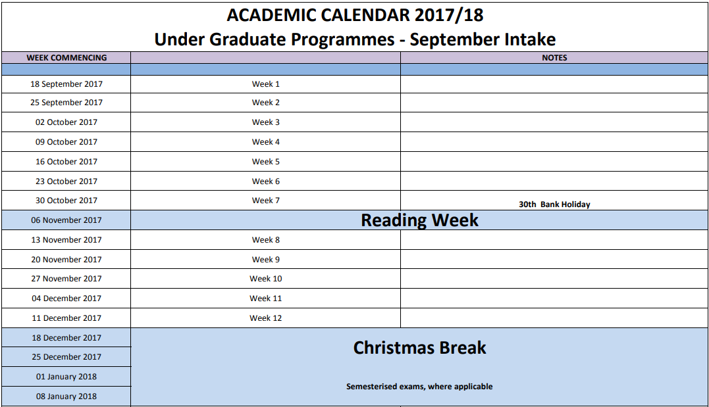

Slide 12
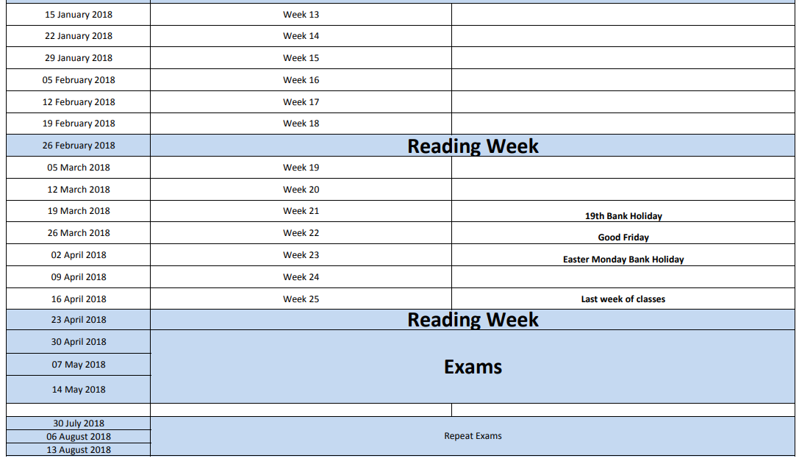

Slide 13
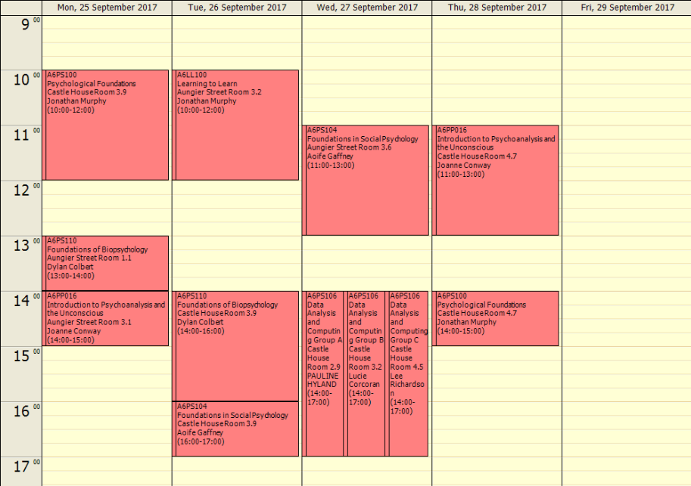
Timetable example (Semester 1: 2017-2018)

Slide 14
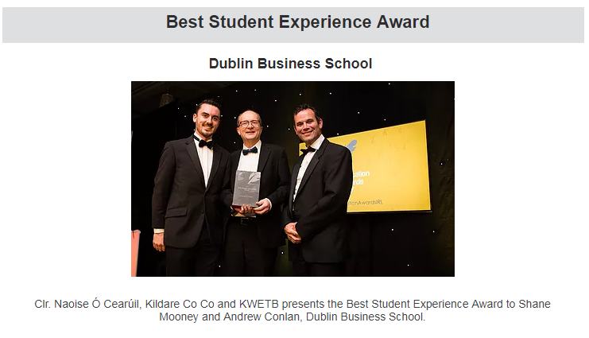
Student Services
Provide advice and support on sourcing accommodation.
Assist students on their health and wellbeing.
Enable students to run multiple clubs and societies.
Form relationships for students with cultural & other support organisations.
Lead the development and maintenance of a DBS community
Work with employers as a means of sourcing placements and jobs for students.
Provide up-to-date information about fields of work, job vacancies, career events, postgraduate courses & research opportunities.
Provide relevant advice, guidance and opportunities for students and graduates to understand their competencies, aspirations and options when seeking employment

Slide 15
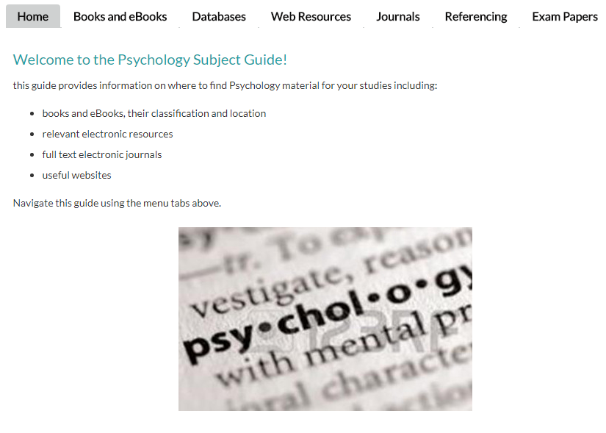
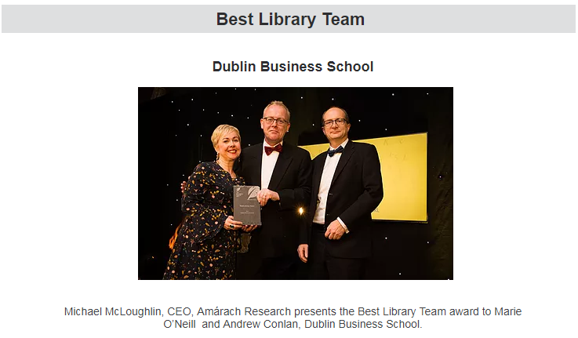
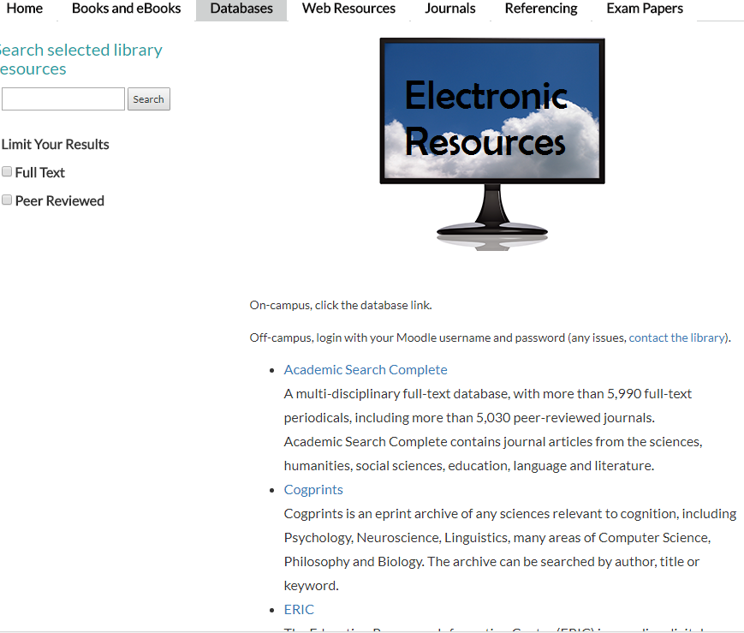
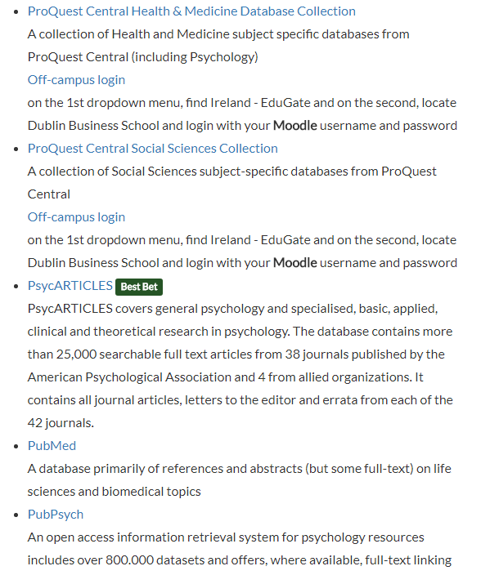
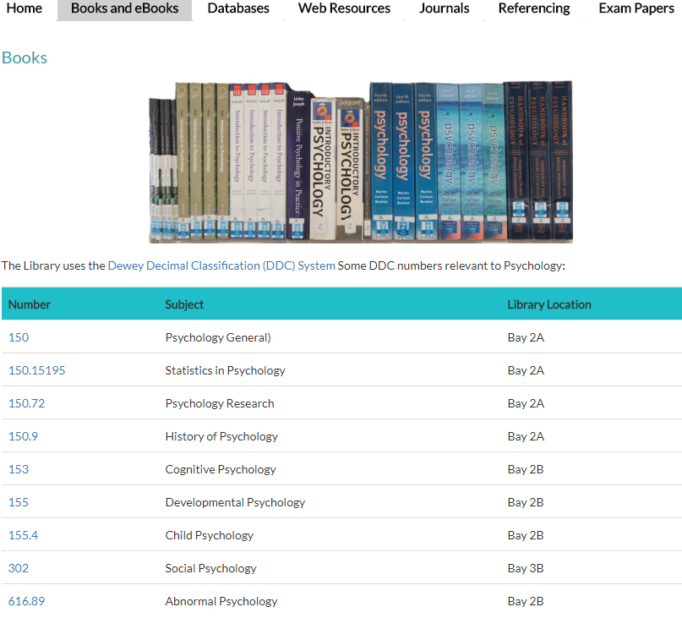
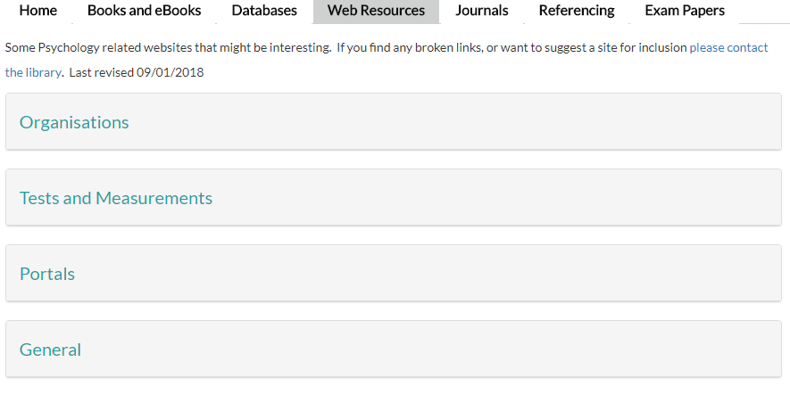
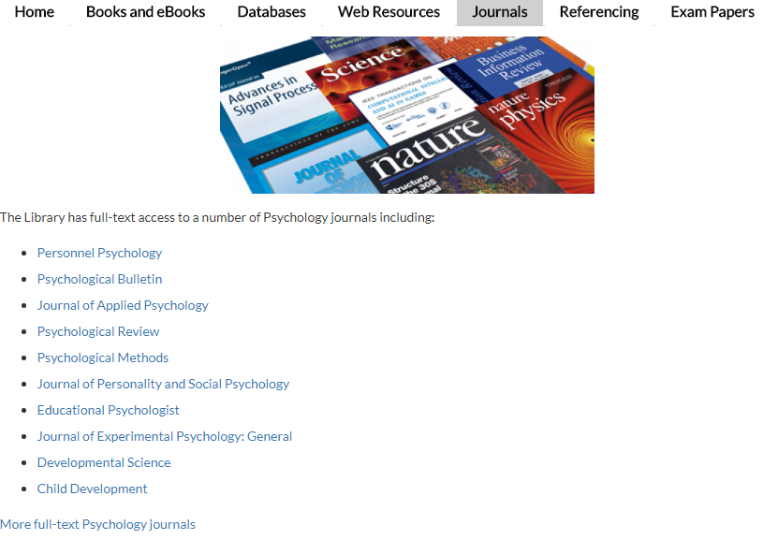
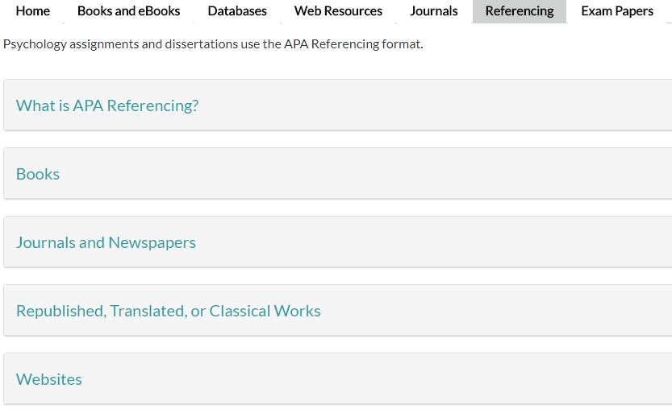

Slide 16
Student Academic Support
Does it get easier or harder as students move through the academic years?

Slide 17
Early Alert
WHOLE SAMPLE
Intermittent and Non-attenders are at least twice as likely to fail compared to frequent attenders
DAYTIME SAMPLE
Target (in descending order of importance):
Arts, level 2, level 1, Irish, Male, Earlier Classes
EVENING SAMPLE
Target (in descending order of importance):
Earlier Classes, Level 3, Level 2, Business

Slide 18
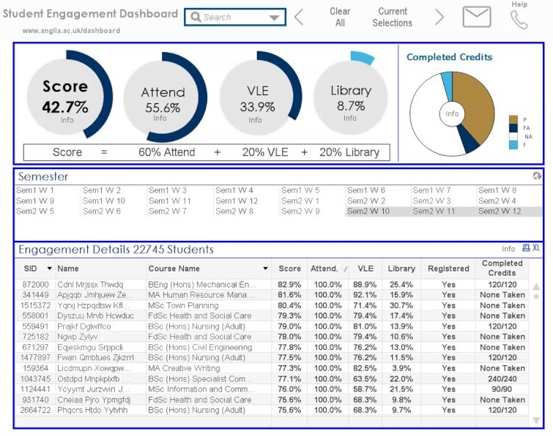
Early Alert (Student Retention)

Slide 19
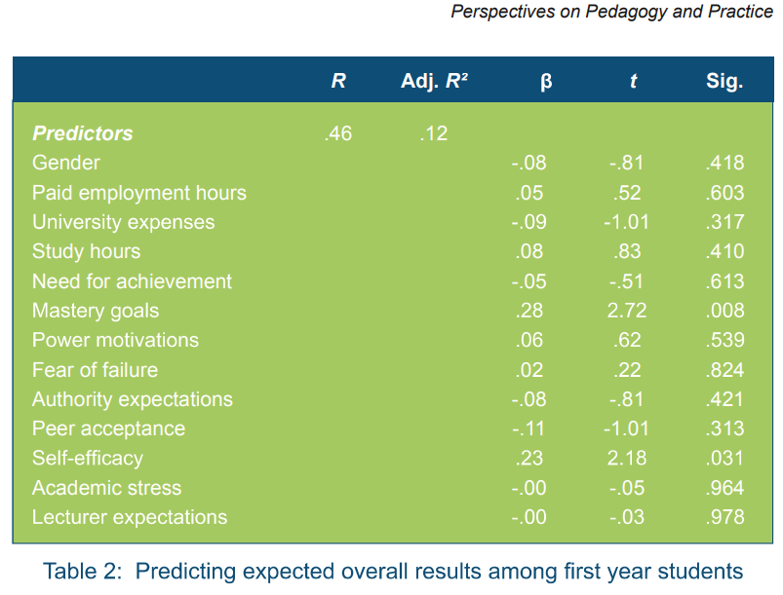
Additional Information
Student Academic Motivation and Confidence

Slide 20
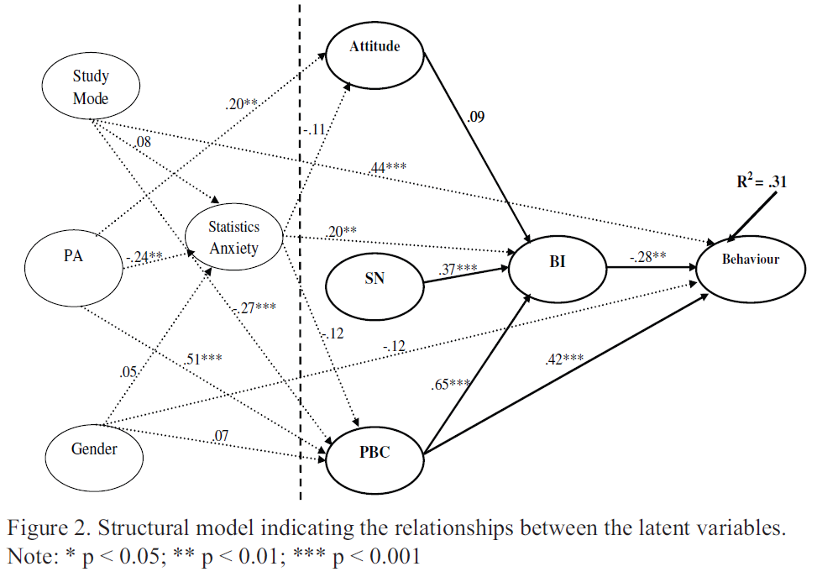
Additional Information
Statistics Modules!

Slide 21
