Slide 1
The biology of stress and stress in everyday life

Slide 2
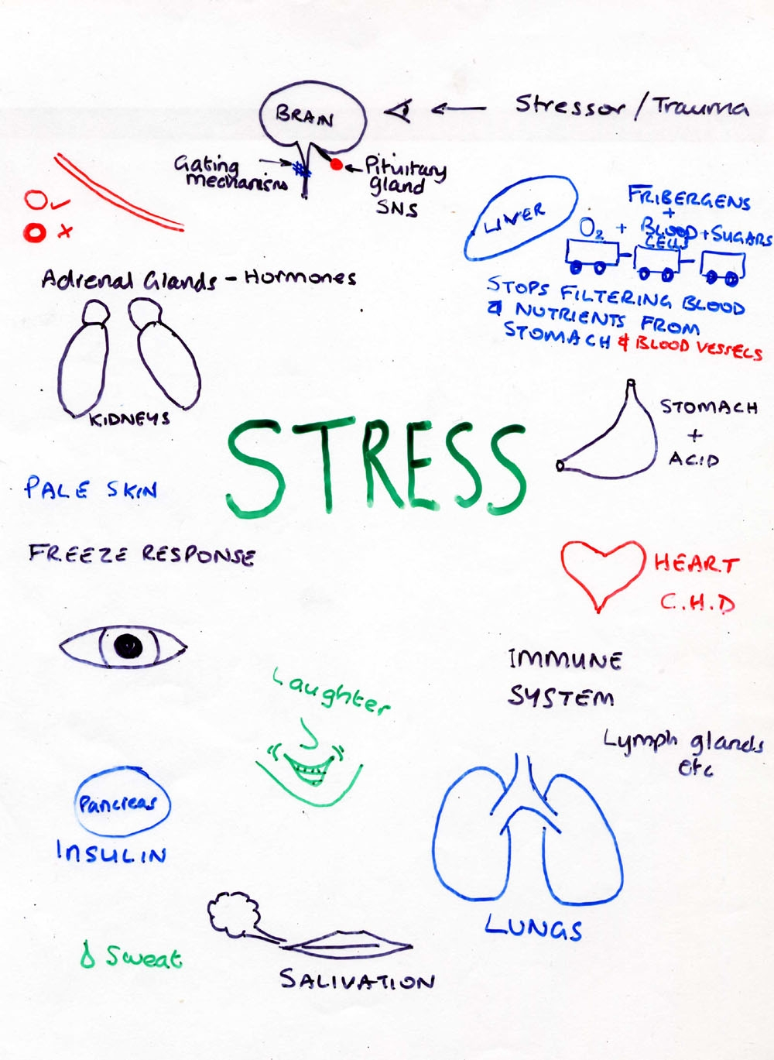

Slide 3
Liver – glucose… blood platelets…
Stomach…
Immune system…
Lungs..
Sweat…
Pancreas…
Pupils…
Pale skin…
Heart…
Adrenal glands…

Slide 4
‘stress is the non-specific response of the body to any demand made upon it’
(Seyle,1974, p.27)
Seyle adopts Canon’s view of stress and he looks at our adaptive response to stress in his General Adaptation Syndrome:

Slide 5
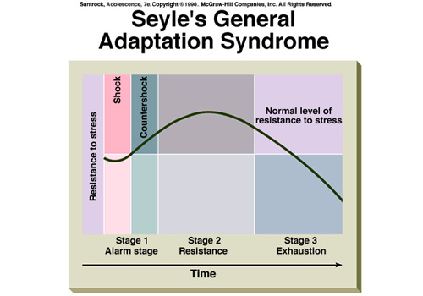

Slide 6
For the Physiological model, psychological factors were seen only as a consequence of this physiological response.
This led to a focus on stress as the factors out there that cause strain on the individual.

Slide 7
The Engineering Model (Holmes and Rahe, 1967)
Stress = external factors that cause strain.
A life event is any event that requires a degree of social readjustment.
They asked over 5000 Ps to identify and rate life events that had been a source of stress in the preceding twelve months.
The Social readjustment Scale is based on the top 43 events:

Slide 8
Holmes and Rahe (1967) Social Readjustment Scale
Had either a lot more or a lot less trouble with your boss [38]
Held a job while attending college [43]
Experienced a major change in sleeping habits (sleeping a lot more or a lot less or sleeping at different parts of the day) [34]
Experienced a major change in eating habits (eating a lot more or a lot less or eating at different times or in different surroundings) [30]
Made a change in your chosen field of study [41]
Have been found guilty of minor violations of the law (e.g. parking or speeding tickets) [22]
Have had an outstanding personal achievement [40]
Had a major change in financial state (you’re a lot worse off or a lot better off than usual) [53]
Changed your residence or living accommodation [42].

Slide 9
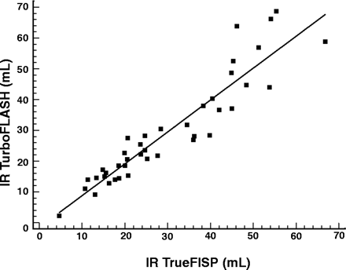
A strong correlation estimating the concordance
rate in life events and stress-related illness
Life events
Stress-related
illness

Slide 10
Evaluations
The stress attributed to positive events is exaggerated.
Correlations=/= cause.
The life event may be the manifestation of stress – if so, it’s not surprise they correlate!
Life events research is retrospective…
A life events focus ignores the role of short-term, more frequent stresses or ‘hassles’
(Moos and Swindle, 1990)

